Slide 1
Overview of
Oracle Warehouse Management System (WMS) &
Oracle Mobile Supply Chain Application (MSCA)

Slide 2
Agenda
Warehouse Management Overview
Overview of Oracle MSCA
Inbound Logistics
Lot Transactions
Inventory Materials Management
Outbound Logistics
LPN Transactions using MSCA
Newly Introduced Oracle WMS Key Features

Slide 3
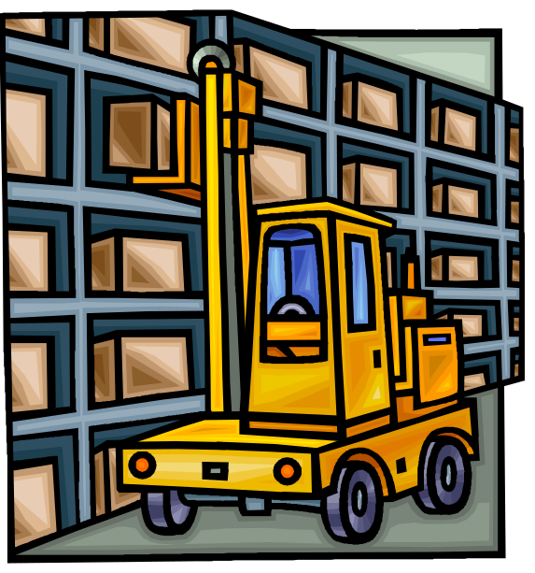
Warehouse Management Overview
Warehouse Management Overview
Overview of Oracle MSCA
Inbound Logistics
Lot Transactions
Inventory Materials Management
Outbound Logistics
LPN Transactions using MSCA
Newly Introduced Oracle WMS Features

Slide 4

About Oracle Warehouse Management System
Oracle Warehouse Management System (WMS) is a component of Oracle's Supply Chain Management and Manufacturing solution.
Oracle Warehouse Management System is advanced inventory module with lot of unique features that improves productivity of distribution centers, manufacturing or inventory handling facilities.
Oracle WMS supports manual data entry, bar code readers scanning for data entry as well as Radio Frequency Identification (RFID) scanning. WMS can be enabled at Inventory organization level.
It spans the areas of warehouse resource management, warehouse configuration, task management, advanced pick methodologies, and value added services.

Slide 5
Key business processes supported by Oracle WMS:
(details are discussed in the following slide)
Oracle Warehouse Management System
Inbound Logistics
Storage and Facility Management
Manufacturing and Value Added Services
Outbound Logistics
Reverse Logistics

Slide 6
Key Warehouse Management Components
The Oracle Warehouse Management functionality spans across the supply chain inventory management spectrum. Specifically, Oracle Warehouse Management addresses the following supply chain inventory management components:
  Inbound Logistics - Includes receiving directly into inventory, receipt inspections, label printing, and rules-based directed put away to storage or opportunistic cross docking.
  Storage and Facility Management - Oracle Warehouse Management extends intra-organization replenishments, container management, storage space optimization, cycle counting and physical inventory, and physical warehouse mapping.
  Value Added Services - Includes labeling, packing, and kitting.
  Outbound Logistics - Includes picking, staging, packing, product consolidation, loading, and shipping.
  Reverse Logistics - Includes product returns, refurbishment, and recycling.

Slide 7
Important Features of Oracle Warehouse Management
License Plate Numbers (LPN): LPN is an object carries the location where it is residing and items that are holding. LPN need not be a physical object, it could be logical grouping. The major advantage of LPN is less number of transactions. Entire LPN can be transacted at once instead of by each item that LPN holds. It also helps with the Inventory Visibility.
Material Status: This is one of the beautiful features of WMS, you can assign status to an item, lot or serial number. Each status is defined with a list of permissible transactions. Example- if you have status called ‘No Sale’ and set the rules such that shipping is not allowed but all other internal inventory movements are allowed. Material status can enforce this kind of business rule.
Label printing: WMS partially supports this functionality. You can define label formats and fields (data) needed, you can associate this with WMS rules to print the label automatically. WMS can generate xml output, but you need a 3rd party label printing/formatting tool to actually print.
Cost groups: This is another major functionality offered by WMS module. In standard Inventory module Inventory valuation accounts are derived by sub-inventory setups. In WMS based on cost group rules you can have different valuations independent of sub-inventories.
Put-away Rules: When a material is received you need to receive into stock. In a major distribution center it is often complex to know where to store the material. WMS offers put-away rules that can be setup based on business criteria. Example- If all hazard material category must be received into hazardous area then put-away rules can be setup.

Slide 8
WMS Rules engine: WMS rules engine enforces the rules defined for put-away, picking, cost group or label printing. You can simulate the results based on set of rules defined. (More details in following slides).
Task Workbench: Task Engine creates tasks like pick, put away, move, replenishment, dispatch etc. Task Workbench or Warehouse Control Board enables management of tasks. These tasks either can be automatically or manually assigned or scheduled to the resources, or resources can pick tasks as they work in the warehouse.
Wave Planning: Oracle WMS facilitates creation, planning and execution of waves in the outbound logistics. This includes selecting / grouping orders for fulfillment, checking availability, labor planning for fulfilling orders, monitoring progress of orders.
Other Important Features:
  Lot Operations: Lot Split, Merge, Translate which are not available in the Oracle Inventory module.
  Crossdocking: Inbound receipts to satisfy outbound demands.
  Cartonization: WMS can automatically suggest packing configurations for groups of items. The system can determine the best carton size in which to pack the material being picked for shipment.
  Labor Management: Oracle WMS provides all the labor management features to support resource planning, management and related tasks.

Slide 9
WMS Rules Engine - Details
Advantages:
    Repository of business restrictions & requirements
    Easier to setup and maintain
    Helps reduce need for customization
    Complexity of rules hidden from view
Functions:
    Suggests material allocations for picking
    Suggests put-away locations for LPNs
    Assigns task types to tasks
    Assigns cost groups to transactions
    Formats labels for printing

Slide 10
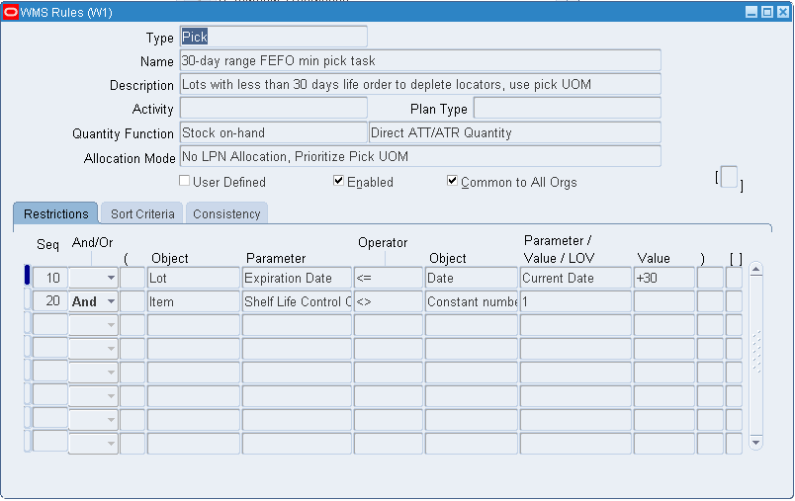
WMS Pick Rule Creation Screen-shot
Rules can be created for these types: Cost Group Assignment, Label Format, Operation Plan Selection, Pick, Put away, Task Type Assignment

Slide 11
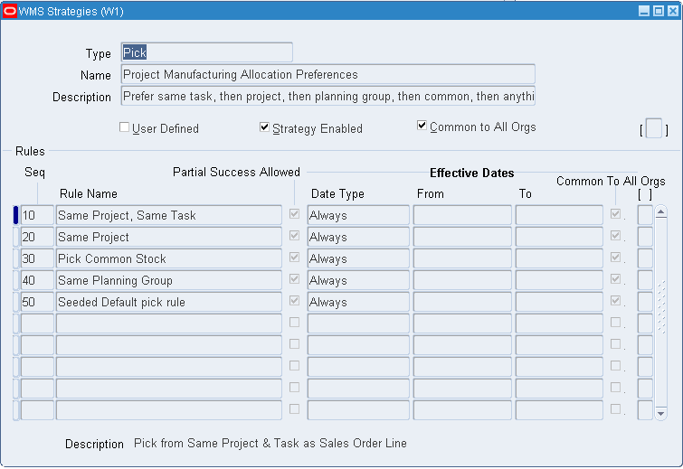
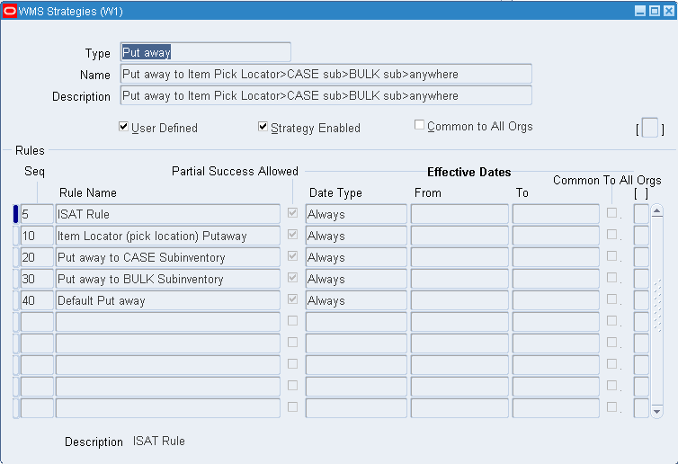
WMS Strategy Creation Screen-shots

Slide 12
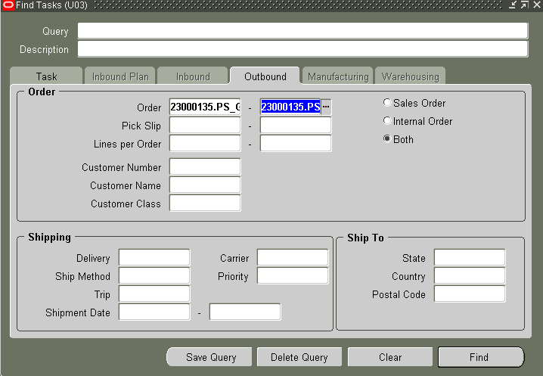
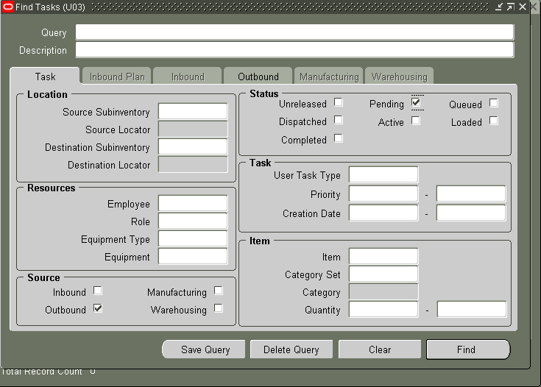
Task Workbench – Screen shots
Query for a task using Sales Order number or Delivery Number with appropriate Task Status.

Slide 13
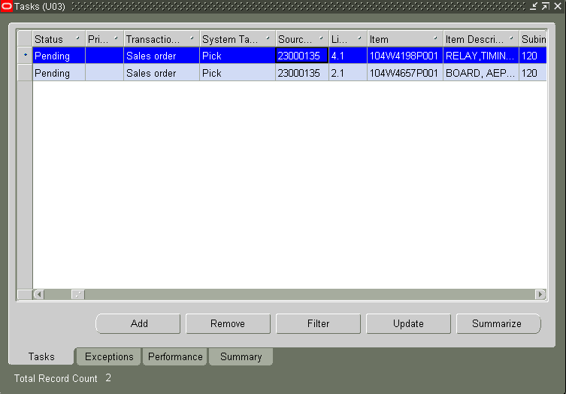
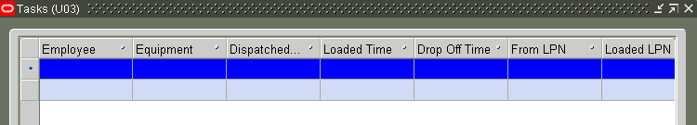
Manual Task Assignment in Oracle WMS
Supervisor assigns the tasks using below screen. Then the tasks appears in the individual queue of the worker for pick/drop.

Slide 14
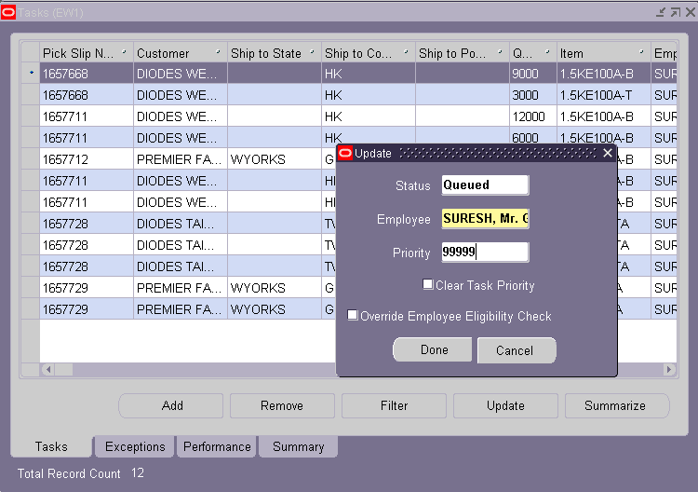
Manual Task Assignment in Oracle WMS – Cntd..

Slide 15
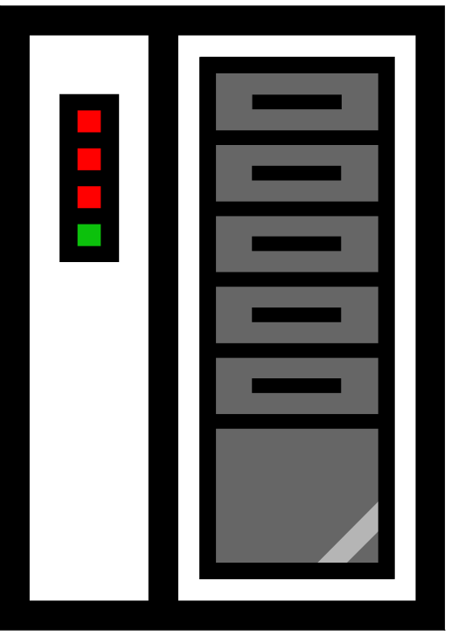
Overview of Oracle MSCA
Warehouse Management Overview
Overview of Oracle MSCA
Inbound Logistics
Lot Transactions
Inventory Materials Management
Outbound Logistics
LPN Transactions using MSCA
Newly Introduced Oracle WMS Features

Slide 16
Oracle Mobile Supply Chain Application Overview
Oracle Mobile Supply Chain Application supports the interface of a mobile client device with a networked computer system.
This application provides the ability to perform shop floor and warehouse transactions from any location in a facility using wireless radio frequency devices that can be hand-held and/or lift truck mounted.
You can perform data entry functions both manually and with a bar code scanner.

Slide 17
MSCA User Interface
You can view all mobile windows with either the graphical user interface or the character - mode interface.
The graphical user interface displays information similar to the desktop application.
Inventory Organizations are not WMS enabled- yet they can still use the MSCA.
MSCA can be accessed using the MSCA GUI on the desktop computers (with the use of a telnet/java client).
Lot splitting is a process that can only be performed using MSCA.

Slide 18




Mobile Navigation
The Oracle Mobile Supply Chain Applications Server enables you to perform transactions using the Telnet Protocol Server.
Telnet Protocol Server

Slide 19
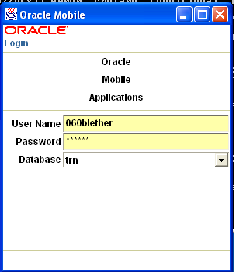
Log On/Off Mobile
To log on to Oracle Mobile Supply Chain Applications, enter your user name and corresponding password.

Slide 20
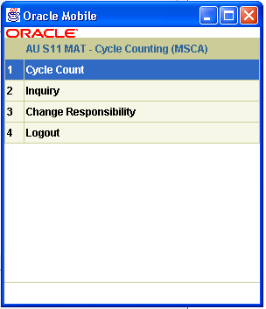
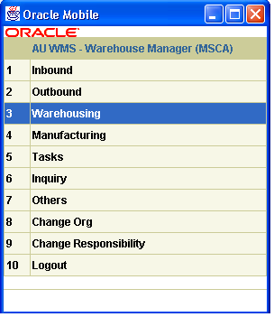
Changing Responsibilities and Organizations
Once you have logged on the mobile device, you can customize the settings by changing either responsibilities and/or Organization.

Slide 21
Navigating in MSCA
Mobile devices used in Oracle Mobile Supply Chain Applications display different characteristics but have common navigation patterns.
You can navigate within the page displayed, enter or find data, and use action buttons. From desktop computers connecting using telnet session, use the “Tab” key to navigate between fields. Action buttons are displayed on the bottom of the GUI to facilitate navigation on a particular screen.
Notes:
Instructor Notes:
You can assign and update ABC classes to an ABC assignment group where an ABC compile was also entered. From the ABC Descending Value Report you determine the cutoff points for assigning ABC classes. You can then use the classifications for other purposes such as determining how often you cycle count a given item.

Slide 22

Inbound Logistics
Warehouse Management Overview
Overview of Oracle MSCA
Inbound Logistics
Lot Transactions
Inventory Materials Management
Outbound Logistics
LPN Transactions using MSCA
Newly Introduced Oracle WMS Features

Slide 23
Inbound Logistics Overview
Inbound logistics refers to receiving, inspection, and put away processes within the warehouse.
MSCA supports receipt of purchase orders (POs) and internal requisitions, return material authorizations (RMAs) and inter-organization shipments in each of three receipt routing methods:
  Direct (receive and put-away)
  Standard (receive and later put-away)
  Inspection (receive, inspect, and later put-away)
WMS provides “Directed Put-Away” functionality in the Mobile forms of MSCA application. The directed put-away functionality is not available in the Core application forms.

Slide 24
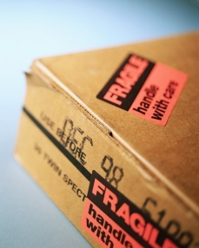




Standard Receipts Process
The Standard receipt process includes the following steps:
1
2
3
Internal Shipment
Purchase Order
Return Material Authorization
Scan Document Number
Scan Receiving LPN
Continue to next
Item, if applicable
7
6
5
4
Receipt
Enter Pack, Slip, or Waybill Information (Optional)
System matches Receipt to Shipment Document
Scan LPN Contents
Notes:
Instructor Notes:
1. The user scans the document number that is being received.
2. The user scans the LPN material that is being received into. Optionally, the user can request a new system-generated LPN through a hot key on the mobile device.
3. In the Project field, enter, select, or scan the project associated with this document line, if visible in a Oracle Warehouse Management enabled Project Manufacturing organization.
4. In the Task field, if applicable, select the task associated with the project.
5. The received material is scanned, including the item numbers, quantities, lots, and serials.
6. The user can select the <Next Item> option to continue receiving again the same document, or he or she can select the <Done> option to proceed to the receipt header.
7. At this point, the system matches the material entered by the user to the shipment lines on the document.
8. On the receipt header page, the user can enter optional information for the receipt, such as pack slip number, waybill, and so on, or can select <Done> to complete the receipt.
.

Slide 25
Receive, Inspect, Put Away Business Process
In the inbound process, inventory is received and put away;
Lot status is applied on put-away depending on the Item/Lot Status Control and Material Status Control configurations;
Lot splitting can be done after receiving to break the lot into multiple lots depending on the storage requirements.
Lot/Material status controls help to prevent automatic reservation of received quantities.

Slide 26
Inbound Logistics Tasks
The following list provides a summary of the inbound logistics tasks supported by Oracle Warehouse Management:
  Receiving with or without ASNs
  Receipt check-in
  Quality control inspection
  Bar code printing
  Directed put-away and storage optimization
  Opportunistic cross docking

Slide 27

Lot Transactions
Warehouse Management Overview
Overview of Oracle MSCA
Inbound Logistics
Lot Transactions
Inventory Materials Management
Outbound Logistics
LPN Transactions using MSCA
Newly Introduced Oracle WMS Features

Slide 28
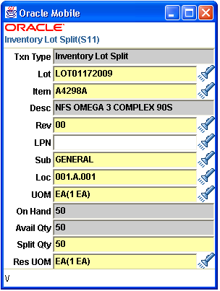
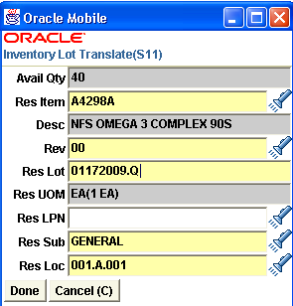
Lot Transactions – Oracle WMS + MSCA feature
Oracle Warehouse Management (WMS) allows the user to split, merge, and translate lots.
A single lot is split into multiple lots, and multiple lots can be merged into a single resulting lot.
A lot can also be translated into a new lot.

Slide 29
Spitting a Lot
Lot splitting process split a parent lot into multiple child lots.
It is useful when a portion of the lot does not have the same lot attributes or material status as the rest of the lot.
It is also useful when a portion of the lot characteristics differs from the rest of the lot.
After a lot is split, the attributes or status of the resulting lots can be changed.
D
E
C
A
B
Parent Lot
C
E
B
A
D
Child Lot 2
Child Lot 1

Slide 30
Merging Lots
Lot merging process merges multiple lots into a single lot instance.
C
A
D
D
E
C
Child Lot 1
A
B
Parent Lot
E
B
Child Lot 2
Merging

Slide 31
Child Lot Splitting and Merging
A child is a lot that is related to another bigger lot, known as the parent lot.
When the system splits or merges a lot, it stores the parent-child relationship between the lots.
The parent-child architecture aids an unlimited number of parent-child levels.
When you split a lot with a parent-child relationship, the parent lot can be entered as a new value.

Slide 32
Lots Translations
Lot Translation either changes the name of an inventory lot to another name, or converts one product to another product.
The lot name, item revision, or subinventory of an existing lot can be changed, and can be moved to another assembly.
Shops will be simple inventory organizations, but will use MSCA for lot splitting for lot status.
D
E
E
D
C
Z
A
B
B
A
Parent Lot
Parent Lot

Slide 33

Inventory Materials Management
Warehouse Management Overview
Overview of Oracle MSCA
Inbound Logistics
Lot Transactions
Inventory Materials Management
Outbound Logistics
LPN Transactions using MSCA
Newly Introduced Oracle WMS Features

Slide 34
Inventory Transactions in WMS
All the inventory transactions (like Transfers, Issues, Receipts) are available in WMS as well (shared functionalities and forms).
When WMS is used, the relevant Inventory transactions would be driven using the WMS Rules logic instead of standard Inventory functionality logic. (Example, Picking Rules, Put-Away Rules, etc).
Oracle WMS does offer several additional features / inventory transactions in conjunction with Oracle MSCA, like Directed Put-Away, Lot Splitting and Merging, LPN functionality, etc.

Slide 35
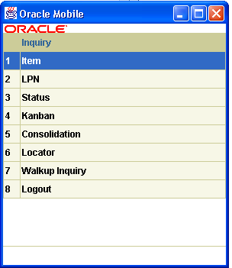
MSCA Inventory Features - Mobile Inquiries
Mobile inquiry pages perform material inquiries.
These inquiries find relevant information about material in Oracle Warehouse Management.
Each type of inquiry finds a different type of information.

Slide 36
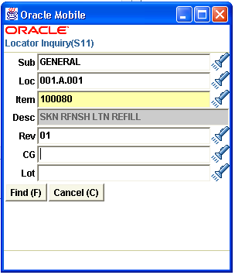
Item Inquiry
Provides the with detailed information about an item like the on-hand quantity, packed quantity, loose quantity, and unit of measure.
If the item is under dual unit of measure control, then it is possible to view the dual unit of measure information.
If the item is under lot control the lot attributes for the item are viewed. If the item is under serial control, the serial details can be viewed.

Slide 37
Account Alias Issue
Oracle Inventory uses transaction types to identify certain transactions to include in historical usage calculations.
If you are not accustomed to enter accounting information, Account alias codes help in preventing errors associated with incorrect account entry.
The predefined transaction type include:
Transaction Type | Transaction Type Description | Transaction Action | Transaction Source Type
Account Alias Issue | Issue material against account alias | Issue from stores | Account alias
Notes:
Instructor Notes:
A transaction type is the combination of a transaction source type and a transaction
action. It is used to classify a particular transaction for reporting and querying
purposes.

Slide 38
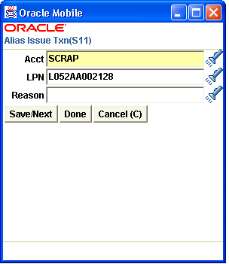
Account Alias
A name or label that represents a general ledger account number.
The user can view, report, and reserve against an account alias.
During a transaction, the account alias can be used instead of an account number to refer to the account.
‘Account Alias Listing’ displays account alias information.

Slide 39
Miscellaneous Receipt
A miscellaneous receipt is usually used for moving material into inventory by charging a specified account.
The following needs to be complete before you can use a miscellaneous receipt:
  The proper General Ledger accounts should be available.
  Item master records have been created for the goods to be issued.
  The appropriate subinventory locations should be identified.
  An inventory accounting period should be open in the organization.

Slide 40
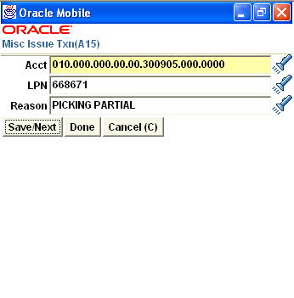
Miscellaneous Issue Transaction
A mobile page exists for the receipt or issue of consigned stock for miscellaneous receipt and miscellaneous issue transactions.
Owning and planning party fields in the page identify the supplier and supplier site combination for the special stock.

Slide 41
Subinventory Transfer
You can use Oracle Warehouse Management to pack LPNs with any grouping of material into a locator. You can then enter the LPN to transact the material.
You can also perform a subinventory transfer when you perform a lot split, merge, or translate.

Slide 42

Outbound Logistics
Warehouse Management Overview
Overview of Oracle MSCA
Inbound Logistics
Lot Transactions
Inventory Materials Management
Outbound Logistics
LPN Transactions using MSCA
Newly Introduced Oracle WMS Features

Slide 43
Outbound Logistics Process Flow
Sales Order
Create Allocations
Assign Task Type
Pick Release
Auto/Manual
For user to pick
System Processes
Assign/Dispatch Tasks
Load Material
Drop Material
User Processes
Reprioritize
Consolidate
Staging Locations
Ship the delivery
Pack in Final LPN

Slide 44



Material Picking Process Overview
Process of selecting orders for release to the warehouse for picking and shipping.
In Auto-Allocations, Oracle Warehouse Management uses the Rules Engine to determine the appropriate material allocations after the orders are released.
Task Type Assignment engine assigns the appropriate task types after the system completes the allocations.
Tasks can also be manually assigned using Tasks Workbench.

Slide 45
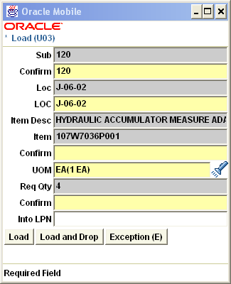
Material Pick
Pick/Load
  Operator goes to Mobile interface and checks the queue
  Picks/Loads into LPN
  User needs to confirm all the information before completing the task.
  Container is suggested Based on item Qty

Slide 46
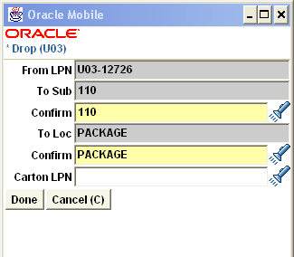
Material Drop
Drop the LPN
  Operator goes to LPN to drop list and picks LPN
  Executes the drop
  For dropping the task onto staging lane the LPN reference of the loaded task has to be used
  Loaded task can be dropped onto the same LPN or a new LPN

Slide 47
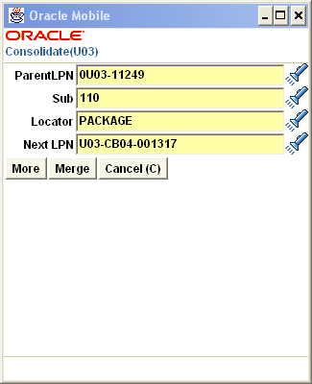
Material Pack
Material is packed in Final LPN.

Slide 48
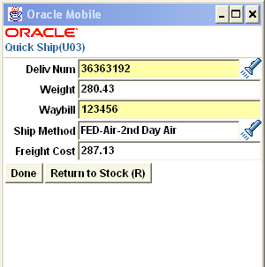
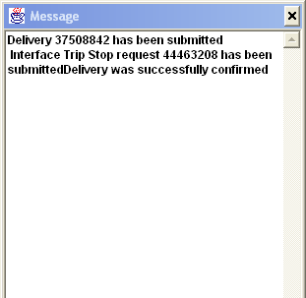
Material Ship
Shipping on Mobile Interface
  Mobile can be used to Ship material out of warehouse
  LPN shipping
  Quick Ship: User can ship material based on delivery number.

Slide 49
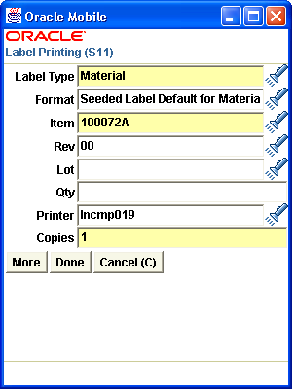
Printing Labels Manually
Situations arise when the user may need to print labels to different printers than what has already been set up.
The ‘Label Printing’ screen allows the user to manually submit requests to print labels using the mobile user interface.
To manually print a label, the user needs to specify the following:
  Label type
  Format
  Printer
  Number of labels to be printed

Slide 50
Printing Labels Manually (contd.)
The fields that is entered on the mobile device to drive the printing of a given label type differ per label type.
The mobile ‘Label Printing’ request screen allows the user to manually request labels for locators and subinventories.
These requests can be initiated one at a time, for each Mobile subinventory and each locator, or they can be issued for all locators of a particular subinventory, or all locators of all subinventories.

Slide 51
View Label Requests
Every request sent for label printing creates a history record.
The user analyzes records of the label requests that have been generated.
The history comprises the XML data that was generated as part of the label request. It also has other information regarding that label request.
The user queries the history of requests based on any of the relevant attributes of the request.

Slide 52
LPN Transactions using MSCA
Warehouse Management Overview
Overview of Oracle MSCA
Inbound Logistics
Lot Transactions
Inventory Materials Management
Outbound Logistics
LPN Transactions using MSCA
Newly Introduced Oracle WMS Features

Slide 53
License Plate Number (LPN)
In Oracle Warehouse Management, a license plate number (LPN) is any object that holds items.
Although LPNs are associated with containers, they need not always represent a physical entity, such as a box. Thus, you can define an LPN as a collection of items.
Oracle Warehouse Management enables you to track, transact, and nest LPNs.
LPNs can only be used in a WMS enabled organization.

Slide 54
Key Terms and Concepts
Receiving Material Into LPNs: All material received through Oracle Warehouse Management is associated with a unique LPN. This enables material to be easily tracked and transacted throughout the warehouse, without scanning the item, quantities, lots, or serials.
Oracle Warehouse Management supports two modes of receiving:
  Express: In Express mode, you need only enter the document number, and optionally the LPN.
  Confirm: In Confirm mode, you need to enter all information about the material being received, such as:
    Document number
    LPN
    Item
    Quantity
    Lot (if applicable)
    Serial number (if applicable)

Slide 55
LPN Transactions
With License Plate Number (LPN) information, you can uniquely identify each container in the supply chain by the LPN assigned to that container.
Inventory Visibility can be improved by the use of LPN. LPN helps tracking of its contents from the time it as receiving till it was shipped or used.
There are three types of LPNs:
  Pre Packed: Completing a quantity into an existing LPN.
  Packing: Generating an LPN when entering the completion transaction. This is initiated using a hot key.
  Pre Generated: Submitting a concurrent request to generate the LPN in advance of completing the assembly.

Slide 56
LPN Transactions (contd.)
With License Plate Number (LPN) information, you can:
  Receive, store, and pick material by LPN
  View on-hand balances by LPN
  View LPN contents
  Use LPNs to perform transactions
  Print labels and reports for referencing container contents
  Track nested LPNs (for example, cartons on a pallet)
  Pack, unpack, consolidate, split, and update LPNs
  Reuse empty LPNs

Slide 57




Generate LPNs
You can generate LPNs using one of the following methods:
  Submitting a concurrent request
  Generate LPNs using a mobile device
You can submit a concurrent request to generate multiple LPNs. These LPNs might be associated with a particular container item, or they could be simply labels with no physical container association.
Store Boxes in Subinventory & Locator
LPNs for Boxes Required
Submit LPN Generation Request
Assign LPNs to Boxes
Notes:
Instructor Notes:
A transaction type is the combination of a transaction source type and a transaction
action. It is used to classify a particular transaction for reporting and querying
purposes.

Slide 58
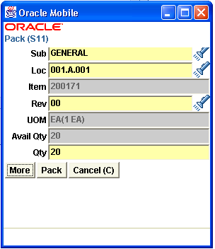
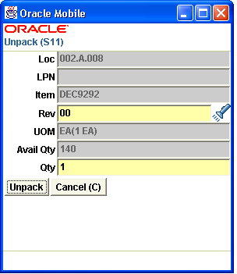
Using Mobile Application to Pack and Unpack Material
You can pack or unpack an item and related LPN serial number using the Mobile Application.
You can also use Packing Workbench to pack or unpack from a desktop (regular Oracle Applications interface).

Slide 59
Warehouse Management Overview
Warehouse Management Overview
Overview of Oracle MSCA
Inbound Logistics
Lot Transactions
Inventory Materials Management
Outbound Logistics
LPN Transactions using MSCA
Newly Introduced Oracle WMS Features

Slide 60
Newly Introduced Oracle WMS Key Features
LSP Functionality:
  Oracle WMS has introduced functionality to cater for “Logistics Service Provider” (LSP) industry or “3rd Party Logistics” (3PL) industry.
  As part of this functionality, WMS works independently and allows creation of client’s POs and SOs and offers billing based on warehouse space utilization, and billing of services performed.
Distributed WMS Functionality:
  As part of this newly introduced functionality, Oracle offers use of WMS module in standalone mode to work with any ERP system. Earlier, it was difficult to implement Oracle WMS module for a customer who wants to use non-Oracle ERP product for all the rest of the functions.
  This functionality also provides features to implement distributed WMS instances which can work together with Oracle or non-Oralce ERP system.

Slide 61
Thank you.

